Slide 1
Chapter 2 – DevOps Overview

Slide 2
Learning Topics
Overview of Agile
Agile and DevOps
What is DevOps?
DevOps Tool Chain
DevOps Lifecycle
DevOps & Automation

Slide 3
Software Development Methodologies
Waterfall believes a team should only start making its software ready for release when all of the functionality for the release has been developed.
Agile introduces the idea that the team should get their software ready for release throughout development. Many variations of agile believe this should be done at periodic intervals.

Slide 4
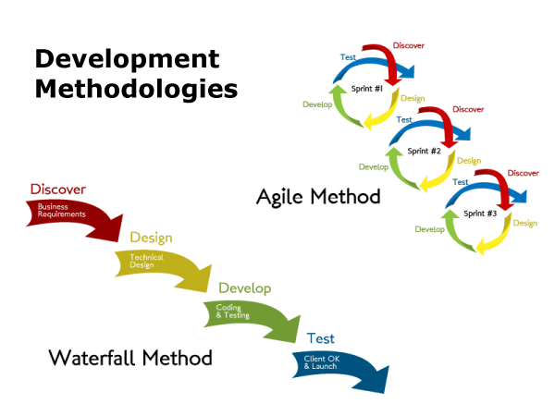
Waterfall Vs Agile

Slide 5
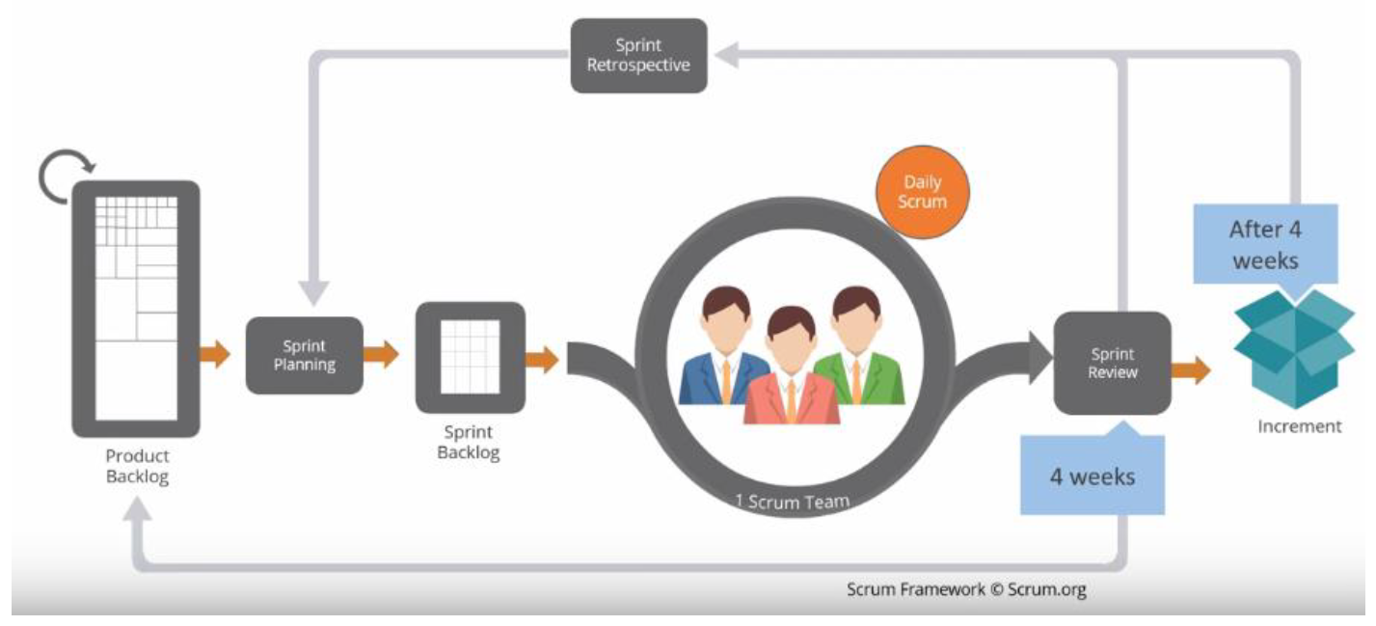
Agile Workflow

Slide 6
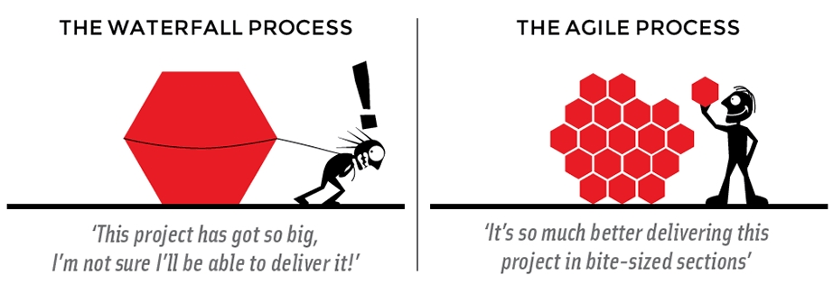
Waterfall Vs Agile
Reduce Blast Radius

Slide 7
Agile & DevOps – How They Inter-Relate?
Some of the principles of Agile manifesto that lead to a DevOps environment
Our highest priority is to satisfy the customer through early and continuous delivery of valuable software
Deliver working software frequently, from a couple of weeks to a couple of months, with a preference to the shorter timescale
Business people and developers must work together daily throughout the project
DevOps - talks about collaboration between all teams including business
DevOps - focuses on automation to complete the many tasks and steps that go into making a deliverable potentially shippable increment
Using tools to replace the non-human steps like build creation, environment setup, trigger test cases, automated deployments multiple times in a day
Notes:
DevOps further extends what Agile says to have business and development work closely. With DevOps Development and operations work closely.
If you can automate a lot of non-human parts of these steps, a lot can be achieved in 4 weeks. Things like triggering a build every time a developer checks in the code in source code repository. Triggering unit test cases before any build are started. Reporting on the pass/fail status of unit test results. Creating deployable packages if the software code passes all unit, integration and performance tests, Configuring your deployment environment like your testing server, staging environment, production environment automatically with the setup you need on each of these server/environments. And of course sending notifications of each step to all the relevant team members and stakeholders.
That can help you gain a lot of time that you can spend on adding value and quality to the software code. This need of Agile to reduce delivery cycles, continuously deliver valuable software actually brought up the need to have all people working on a project from business to developers to operations to work closely and transparently to understand the scope of software project, its impact on end customer, value aspect of the software, its potential challenges in production where the real customers will be using it. This helps prevent a lot of issues that would later come up once a software code would be pushed to production after months of analysis, design, coding, testing. This saving us all that valuable time and reducing incidents in production, leading to improved customer satisfaction.

Slide 8
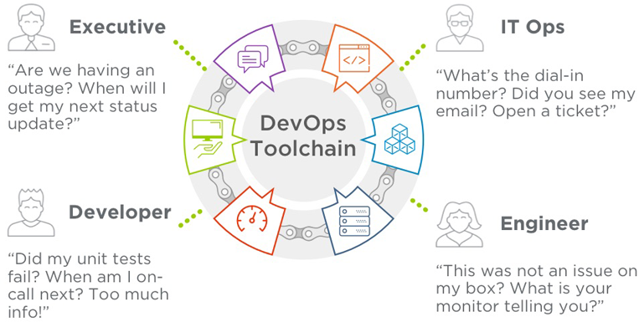
Project Stakeholders Issues

Slide 9
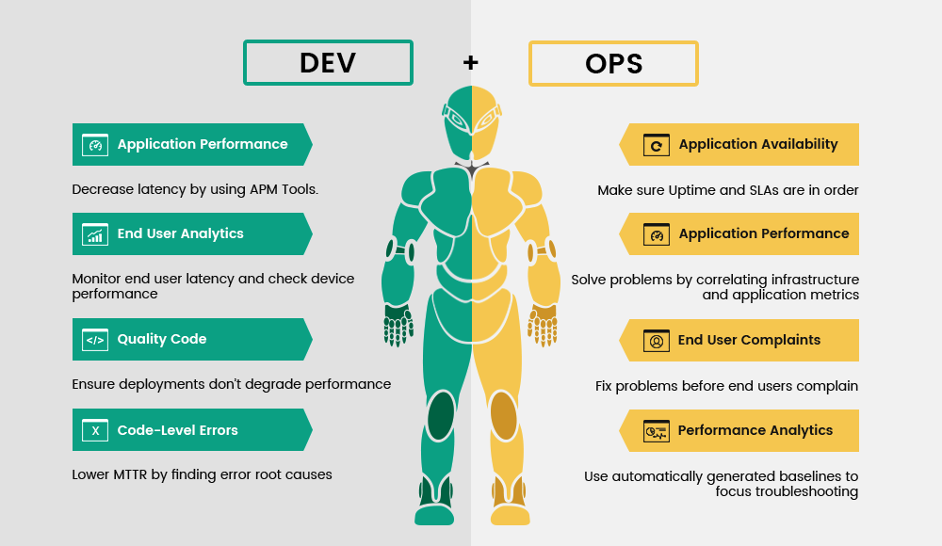
Project Stakeholders Responsibilities

Slide 10
What is DevOps?
DevOps is a software engineering culture and practice that aims at unifying software Development and Software Operations.
DevOps aims at shorten the development cycles, and increase deployment frequency, and have more dependable releases.
DevOps is predominantly about culture and tools are secondary.

Slide 11
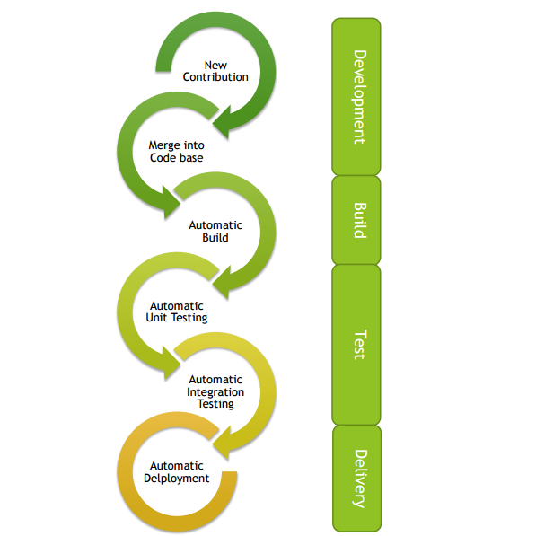
What is DevOps?
DevOps culture is all about collaboration between developers and other parties involved in end to end software development life cycle.
Since one of the goal of DevOps is to have frequent releases - Its emphasis is on automating processes required to release and change software

Slide 12
What is DevOps?
Set of principles and practices
Helps to deploy software better, faster
Advocates automation and monitoring
Recognizes interdependence of development and operations
Using shared set of tools
Culture
Automation
Measurement
Sharing

Slide 13
Challenges for DevOps?
Who owns culture?
Everyone has a tool
Cloud or legacy?
Marginalized budgets
Technical complexity
Alert swarm
Disruption of traditional ops

Slide 14
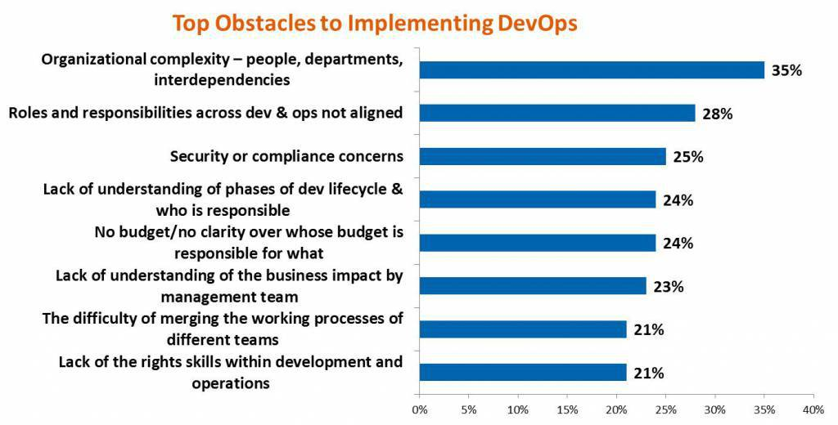
Challenges for DevOps?

Slide 15
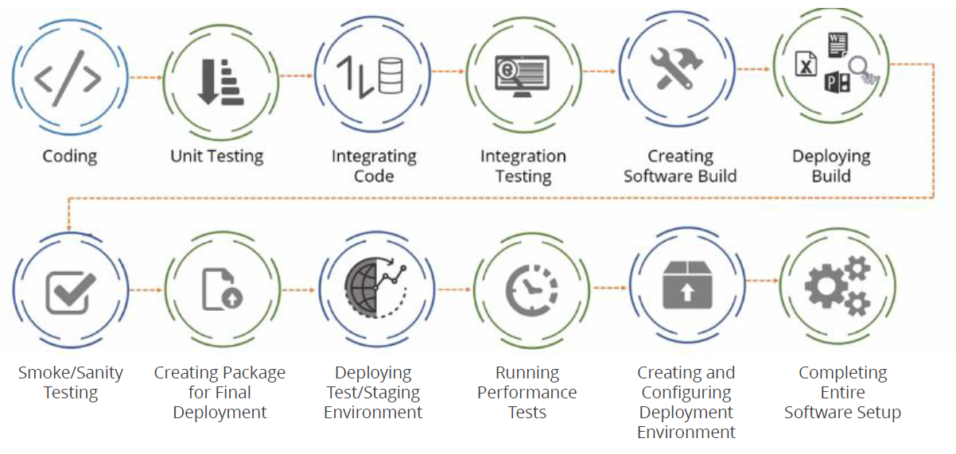
Software Development Life Cycle

Slide 16
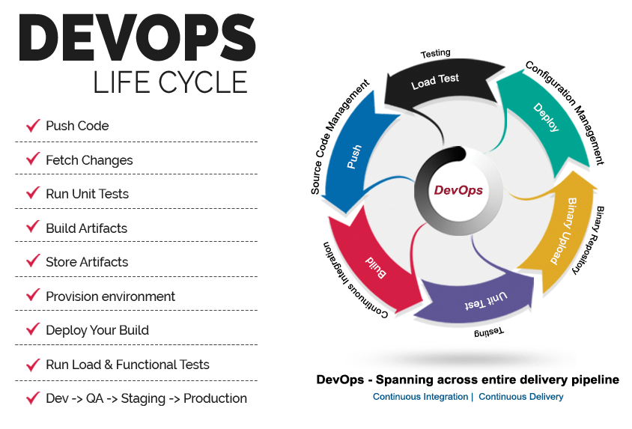

Slide 17
DevOps Key Behviors
Strive for clarity, challenge uncertainties in requirements
Challenge the validity of assumptions
Seek simplicity and reliability; do not strive to produce the optimal design
Seek the least risky design that meets requirements
Avoid adding extra code or features beyond the bare minimum
Fix the root cause of each issue instead of patching to fix the symptoms

Slide 18
DevOps Goals
Increased frequency of software deployment
Increased collaboration
Reduction in cost of software development
Reduce testing time
Leverage standardized integrated software tools
Improve performance of individuals and teams
Increased agility
Reduced outages

Slide 19
Top 5 Predictors of IT Performance
Peer-reviewed change approval process
Version control for all production artifacts
Win-win relationship between dev and ops
Proactive monitoring
High trust organizational culture
*Source: State of DevOps Report – Puppet Labs

Slide 20
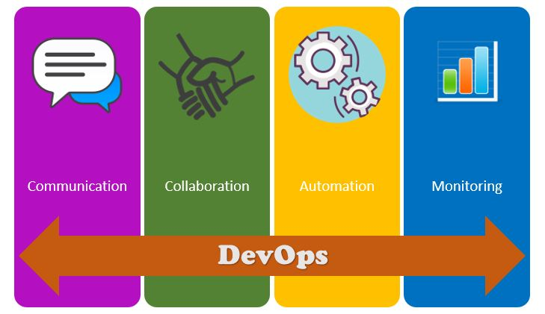
4 Pillars of DevOps

Slide 21
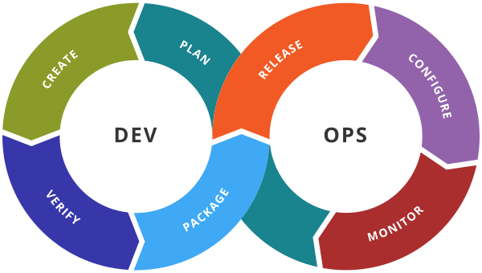
DevOps Toolchain
A DevOps toolchain is a set or combination of tools that aid in the delivery, development, and management of applications throughout the software development lifecycle, as coordinated by an organisation that uses DevOps practices.
Generally, DevOps tools fit into one or more activities, which supports specific DevOps initiatives:
Plan/Requirement
Create/Development
Verify/Test
Package/Artifact
Release
Configure, and Monitor.
Notes:
One of the big challenges for a DevOps practitioner is selecting the right set of tools to support their work and workflow.
In our industry there is no shortage of tools! There are specialized tools, broad spectrum tools, open-source tool projects and commercial offerings and tools focused on different Software Development Lifecycle phases. This abundance of tools can make it hard to even narrow down the list of tools to be considered.
One wants to identify best of breed in each category of tool and be aware that these tools should work together as the full DevOps workflow is defined and refined.
Planning Tool -
Tools supporting the requirements phase should be able to improve communication in the team and to capture and document requirements, issues, and designs.
Some types of tools in this category are those that help with issue and task management.
Tools that support UML diagrams are helpful when discussing code patterns and designs.
Wikis are good general purpose idea and thinking capture tools.
Agile development methodology has a set of tools designed to support developers.
Share calendars are something you might not think about – but they are very helpful when you need an overview of team activities.
Word processors – a pretty generic category of tools – can also be important for creating ways to communicate within a team.
Development Tools
There are a wide variety of code development tools.
These start with editors. Even through Integrated Development Environments are extremely popular because they combine an editor, compiler, debugger, and more there are times when a pure best of breed tool is an important asset.
Of course, language compilers are critical – they are the main tool that must be used to translate our textual program representation to executable code representations. If our language is interpreted, we will needs it interpreter.
There is a rich set of choices for Unit testing and mocking frameworks.
For specific layers of a software system there are user interface, integration layer, and database mapping frameworks to learn about and master.
Code quality tools are really code defect reporting tools. As you will see later, we will focus on increasing quality by focusing on removing defects. Code quality and code review tools help with this effort.
Build tools are focused on the construction of software artifacts from our source code and configuration files.
And finally, we need to have a way to capture and persist data. This would be the category of databases and general persistence mechanisms.
Test Tools
Tools focused on testing are available with different points of focus. A unit test and mocking framework is focused on fine-grained software element testing in isolation. They test a small “unit” of software.
Later software is assembled from these tested parts and larger scale or large scope testing must be done. This testing can be facilitated by testing harnesses that pull together parts and structure these larger scale tests. A valuable approach to testing is to script the actions a user would use to activate a particular “user story”. If the testing is done through the final user interfae then user-interface recording and playback tools can be very helpful as they can drive the user interface from the outside.
Package Tools
A software system is brought together into a final unit of executable code and then must be prepared or packaged for the destination environment. The tools that help with this process are called “Packaging Tools”. The exact functionality and desired features depend on the destination.
Build tools are critical as they are responsible for the actual assembly of software. Build tools can be based on a wide range of approaches from being programmable in their own DSL or may be fully declarative.
Repositories are systems that can hold intermediate or final software units.
Container management tools differ depending on the type of container used. Destination containers could be a light weight container system such as Docker or a heavy-weight container such as the Java2EE container system.
Complex containers such as the Java Enterprise Stack require deployment descriptors that can be amazinlyg complex. It is far better to use an alternate DSL to describe these descriptors and generate the descriptors automatically.
Release Management Tools
The release of a software system is a major event. It is usually a high-ceremony process that involves many people.
I once witnessed the release of an update to a major retailer’s web site. It involved teams of people filling three conference rooms to overcrowding. So many facets of the system had to be checked, rechecked, and then communicated it required this large live gathering of technologists.
Instead of having a live team of people overseeing the release of a software upgrade it is best for a DevOps practitioner to define the release process with release automation tools. As you will learn in this course and as you become experienced at Devops you will appreciate and embrace as much automation as you can include in your processes. Automation means having a regular, auditable, and fixable process. If left to humans, errors will occur at random points which may be hard to find and fix.
Driving this are Task Scheduling tools These are responsible for the scheduling and coordination of various tasks in the DevOps process.
And change is what releases are all about – new software, updated software – it is all about change. Change management systems make this manageable.
And when it comes to pushing forward with a release, approvals must be obtained from various parties. There are systems that can help with the approval process.
If a release is “bad” then it must be rolled back quickly and precisely. This is the role of a rollback mechanism. Hopefully, this is not required!
Finally – Enterprise integration tools are needed if you are working on the very largest of software systems. These are truly enterprise scale and must integrate with other parts of the enterprise. Enterprise integration tools help with this scale of software.

Slide 22
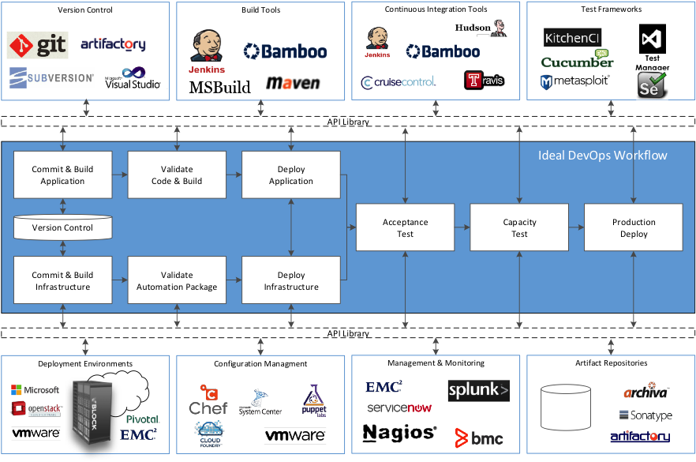
DevOps Tool Chain

Slide 23
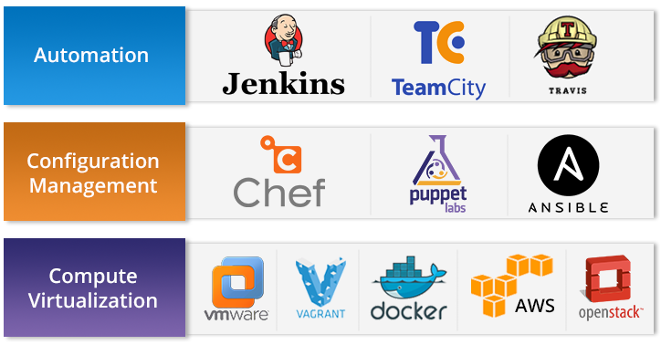
DevOps Tools For Training

Slide 24
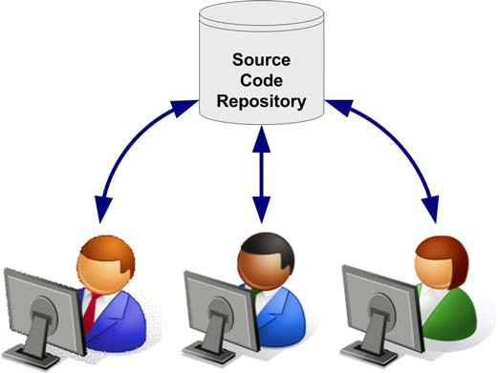
Source Version Control
What is Version Control?
Version control is a system that records changes to a file or set of files over time so that you can recall specific versions later.
It help with tracking changes made to each and every part of your source code.
Notes:
Version control systems are a category of software tools that help a software team manage changes to source code over time. Version control software keeps track of every modification to the code in a special kind of database. If a mistake is made, developers can turn back the clock and compare earlier versions of the code to help fix the mistake while minimizing disruption to all team members

Slide 25
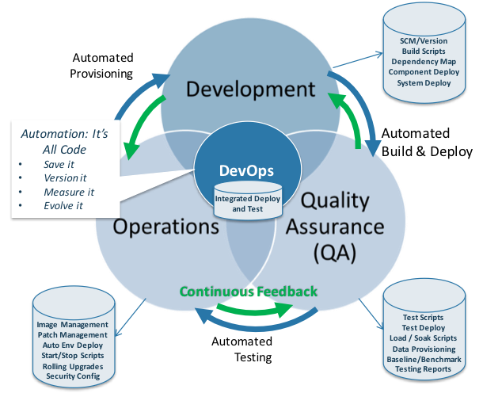
Version Control in DevOps
Versioning becomes critical to business success because corporate value is often contained in the software assets created by the company.
Long long ago, there used to be “The Build Team”. Build Team lived in a world of Cron, Bash, Perl, and nightly builds. It’s hard to believe in today’s world that 24-hour turnaround was once considered standard practice.
Notes:
Version control systems are a category of software tools that help a software team manage changes to source code over time. Version control software keeps track of every modification to the code in a special kind of database. If a mistake is made, developers can turn back the clock and compare earlier versions of the code to help fix the mistake while minimizing disruption to all team members

Slide 26
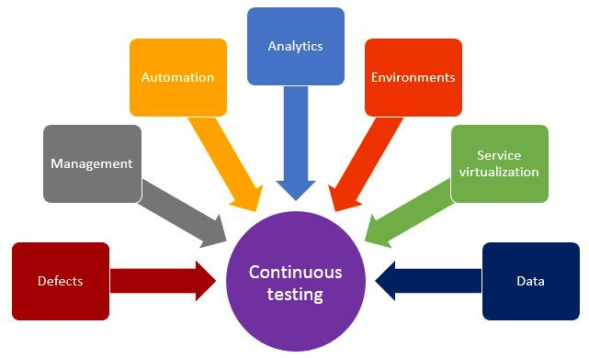
Continuous Testing (CT) and DevOps
“Continuous testing enables a project team to execute tests when needed, not when possible.”
Informed customers demand seamless user experience.
Applications need an extraordinary connectivity and dependence between processes, systems, and infrastructure.
Testing various complex applications, products, and services can pose a big challenge as testing needs to make sure that high-quality software is delivered at fast-track speed.
Notes:
Continuous testing enables the trust of the whole team by providing immediate feedback on the quality of the solution. For the business stakeholders, continuous testing increases the confidence that a delivery can be relied upon and that there is minimum risk on business impact. For a project delivery team, continuous testing techniques and tools minimize the impact of testing which can reduce project costs, enable faster delivery of the solution and most importantly, ensure that a high quality, reliable solution is delivered.

Slide 27
Testable User Stories
Agile development often specify requirements in terms of user stories
Effective user stories need to be testable
Features of effective user stories are SIT - Small Independent Testable :
It needs to describe an action which has value to a specific user
It needs to target a specific user or role
It needs to have clearly stated acceptance criteria which can easily be tested
It needs to be small enough to implement in a few days
It needs to be short and precise
Notes:
When you are using Agile development requirements are often specified in terms of user stories. Each of these user stories must be tested.
To make a user story amenable to testing:
Its needs to describe an action which has value to a specific user
It needs to target a specific user or role
It needs to have clearly stated acceptance criteria which can be tested
It needs to be small enough to implement in a few days
It needs to be short and precise

Slide 28
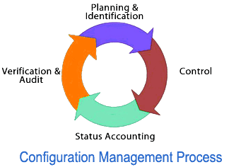
Configuration Management
Configuration management is the process of standardizing resource configurations and enforcing their state across IT infrastructure in an automated yet agile manner.
Configuration management represents the one true source of the configuration items. A configuration item is anything that can be configured and that is absolutely necessary for the success of your project.
For example, source codes, property files, binaries, servers, and tools can all be configuration items for a software firm
Notes:
The Process of Configuration
The configuration management process takes into consideration the following broad-set activities:
Configuration identification — The configuration that needs to be maintained first must be identified. It can either be a manual process, such as maintaining the source code on a common repository or using discovery tools to automatically identify the configuration.
Configuration control — Once the configuration items are identified, there is no guarantee that it will remain unchanged. In all probability, the configuration is likely to change. Thus, there needs to be an effective mechanism to control the changes that go into the configuration management system. In most configuration management frameworks, the change management process acts as a guardian for controlling the changes to the configuration management system.
Configuration audit — Despite there being control mechanisms protecting against changes in configuration, means of bypassing exist. Therefore, configuration audits are necessary to keep an eye on configuration compliance.

Slide 29
Configuration Management in DevOps
DevOps starts and ends with configuration management
Configuration management in DevOps is made up of:
Source Code Repository — Used primarily during the development phase.
Artifact Repository — Used during the development and operations phases.
Configuration Management Database — Used during the development and operations phases for following activities
Change management
Provisioning environments
Incident management
Infrastructure as Code

Slide 30
Continuous Integration
Requires developers to integrate code into a shared repository
Each check-in is verified by an automated build
Allowing teams to detect and solve problems quickly
Integrate at least daily
Spend less time debugging and more time adding features
“Continuous Integration doesn’t get rid of bugs, but it does make them dramatically easier to find and remove.”

Slide 31
Continuous Delivery
Extends continuous integration
Provides fast, automated feedback on the production readiness of system
It can help large organizations become as lean, agile and innovative as start-ups
Reliable, low risk releases
Test, support, development and operations work together as one delivery team to automate and streamline the build-test-release process
Enables push button deployments on demand
Continuous delivery does not mean that you are deploying every day. It means that you COULD release when necessary

Slide 32
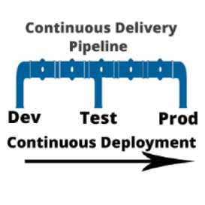
Continuous Deployment
Set of practices that enable every change that passes automated tests to be automatically deployed to production
Removes the manual step in continuous delivery pipeline
Results in multiple deployments per day

Slide 33
DevOps and Automation
Automation is an essential element
Automation enables agility, consistency, speed and reliability
Treating infrastructure as code
Repeatable and reliable deployment processes
Development and automation testing performed against production-like systems
On-demand creation of development, testing etc. environments
Proactive monitoring
Shared access to automated testing, deployment and monitoring tools
Streamlines software delivery and prepares Ops for the long run

Slide 34
This concludes Chapter 2 – DevOps Overview Let us move to Chapter 3 – SCM with GitHub

